Slide 1
Lecture 26: Final Multiple Choice Exam (More on searching/sorting)
Copyright (c) Pearson 2013. All rights reserved.

Slide 2
MC Exam Thursday
You will get the full, 40 MC questions exam Thursday and required to do exactly 20 questions. The exam is an actual AP exam.
Pick ANY 20 questions, but choose 20 that you can do and are confident you can get the right answer in 2 minutes or less. You will submit your answer key at the end of class and keep the test for to finish for homework.
Don’t spend more than 2 minutes on any question.
A lot of the easy questions are in the first 30 questions. (same on AP?) But there are several easy questions in the last 10 questions.
Skip lengthy questions on your first pass.
The goal is the get most of the 20 questions right (14-20).

Slide 3
MC Exam Thursday
Keep the test and finish for homework.
On Friday, I will post answers and we will go over it in class.
Please time yourself in the take home portion. If you finish the test early, you can turn it in early but note the time you have left. You can use this extra time to do the second, more difficult half.

Slide 4
Sequential search
sequential search: Locates a target value in an array/list by examining each element from start to finish.
How many elements will it need to examine?
Example: Searching the array below for the value 42:
Notice that the array is sorted. Could we take advantage of this?
index | 0 | 1 | 2 | 3 | 4 | 5 | 6 | 7 | 8 | 9 | 10 | 11 | 12 | 13 | 14 | 15 | 16
value | -4 | 2 | 7 | 10 | 15 | 20 | 22 | 25 | 30 | 36 | 42 | 50 | 56 | 68 | 85 | 92 | 103
i

Slide 5
Binary search (13.1)
binary search: Locates a target value in a sorted array/list by successively eliminating half of the array from consideration.
How many elements will it need to examine?
Example: Searching the array below for the value 42:
index | 0 | 1 | 2 | 3 | 4 | 5 | 6 | 7 | 8 | 9 | 10 | 11 | 12 | 13 | 14 | 15 | 16
value | -4 | 2 | 7 | 10 | 15 | 20 | 22 | 25 | 30 | 36 | 42 | 50 | 56 | 68 | 85 | 92 | 103
min
mid
max

Slide 6
Searching Analysis
Sequential Search:
Best case: The first slot is the target key.
Worst case: The last slot is the target key or the target is not in the array.
Average: On average, it takes n/2 comparisons where n is the length of the array.

Slide 7
Searching Analysis
Binary Search:
Best case: The key is found on the first try, i.e., (low+high)/2 is the index of the target.
Worst case: The key is in the last slot or not in the array. Here the n elements must be divided by 2 until there is just one element, and then that last element must be tested. It takes approximately log_2(n) comparisons. For example, if the length of the array is 35, then in the worst case, it will take approximately log_2(35), which is between and 5 and 6, comparisons.
(since 2^5=32 and 2^6=64 and x=log_2(35) such that 2^x=35, x must be between 5 and 6, closer to 5.)

Slide 8
Selection sort
selection sort: Orders a list of values by repeatedly putting the smallest or largest unplaced value into its final position.
The algorithm:
Look through the list to find the smallest value.
Swap it so that it is at index 0.
Look through the list to find the second-smallest value.
Swap it so that it is at index 1.
...
Repeat until all values are in their proper places.

Slide 9
Selection sort example
Initial array:
After 1st, 2nd, and 3rd passes:
index | 0 | 1 | 2 | 3 | 4 | 5 | 6 | 7 | 8 | 9 | 10 | 11 | 12 | 13 | 14 | 15 | 16
value | 22 | 18 | 12 | -4 | 27 | 30 | 36 | 50 | 7 | 68 | 91 | 56 | 2 | 85 | 42 | 98 | 25
index | 0 | 1 | 2 | 3 | 4 | 5 | 6 | 7 | 8 | 9 | 10 | 11 | 12 | 13 | 14 | 15 | 16
value | -4 | 18 | 12 | 22 | 27 | 30 | 36 | 50 | 7 | 68 | 91 | 56 | 2 | 85 | 42 | 98 | 25
index | 0 | 1 | 2 | 3 | 4 | 5 | 6 | 7 | 8 | 9 | 10 | 11 | 12 | 13 | 14 | 15 | 16
value | -4 | 2 | 12 | 22 | 27 | 30 | 36 | 50 | 7 | 68 | 91 | 56 | 18 | 85 | 42 | 98 | 25
index | 0 | 1 | 2 | 3 | 4 | 5 | 6 | 7 | 8 | 9 | 10 | 11 | 12 | 13 | 14 | 15 | 16
value | -4 | 2 | 7 | 22 | 27 | 30 | 36 | 50 | 12 | 68 | 91 | 56 | 18 | 85 | 42 | 98 | 25

Slide 10
Insertion Sort
insertion sort: Shift each element into a sorted sub-array
faster than selection sort (examines fewer values)
index | 0 | 1 | 2 | 3 | 4 | 5 | 6 | 7 | 8 | 9 | 10 | 11 | 12 | 13 | 14 | 15 | 16
value | -4 | 12 | 18 | 22 | 27 | 30 | 36 | 50 | 7 | 68 | 91 | 56 | 2 | 85 | 42 | 98 | 25
sorted sub-array (indexes 0-7)
7
Notes:
A lot of 143 students implement a kind of insertion sort on their SortedIntList add operation.

Slide 11
Insertion Sort Algorithm
Check element.
If larger than the previous element, leave it.
If smaller than the previous element, shift previous larger elements down until you reach a smaller element (or beginning of array).
Insert element.

Slide 12

Insertion Sort Algorithm
64 54 18 87 35
54 less than 64
Shift down and insert 54
54 64 18 87 35(1st pass)
18 less than 64
18 less than 54
Shift down and insert 18
18 54 64 87 35(2nd pass)
87 greater than 64
Go to next element
18 54 64 87 35(3rd pass)
35 less than 87
35 less than 64
35 less than 54
35 greater than 18
Shift down and insert 35
18 35 54 64 87(4th pass)

Slide 13
Merge sort
merge sort: Repeatedly divides the data in half, sorts each half, and combines the sorted halves into a sorted whole.
The algorithm:
Divide the list into two roughly equal halves.
Sort the left half.
Sort the right half.
Merge the two sorted halves into one sorted list.
Often implemented recursively.
An example of a "divide and conquer" algorithm.
Invented by John von Neumann in 1945

Slide 14
Merge sort example
index | 0 | 1 | 2 | 3 | 4 | 5 | 6 | 7
value | 22 | 18 | 12 | -4 | 58 | 7 | 31 | 42
split
22 | 18 | 12 | -4
58 | 7 | 31 | 42
split
split
22 | 18
12 | -4
58 | 7
31 | 42
split
split
split
split
22
18
12
-4
58
7
31
42
merge
merge
merge
merge
18 | 22
-4 | 12
7 | 58
31 | 42
merge
merge
-4 | 12 | 18 | 22
7 | 31 | 42 | 58
merge
-4 | 7 | 12 | 18 | 22 | 31 | 42 | 58

Slide 15
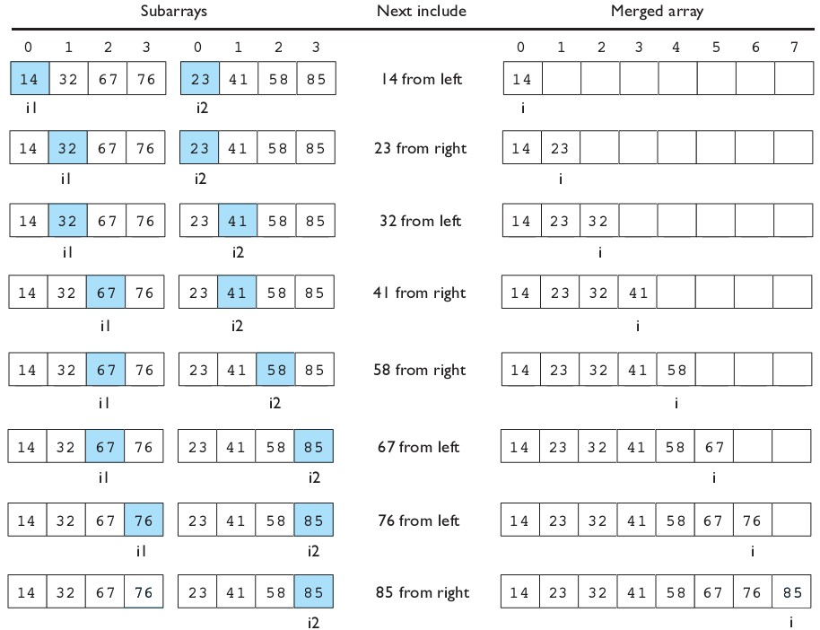
Merging sorted halves

Slide 16
Sorting Analysis
Selection Sort
The best case and worst cases, and generally all cases, for selection sort require the same number of moves and comparisons.

Slide 17
Sorting Analysis
Insertion Sort
The worst case for insertion sort occurs if the array is initially sorted in reverse order, since this will lead to the maximum possible number of comparisons and moves.
The best case for insertion sort occurs if the array is already sorted in increasing order. In this case, each pass through the array will involve just one comparison, which will indicate that “it” is in the correct position with respect to the sorted list. Therefore, no elements will need to be moved.

Slide 18
Sorting Analysis
MergeSort
MergeSort is the fastest of the three sorts on the AP exam. The only disadvantage of mergesort is that it requires a temporary array as big as the original array.
The best, worst, and average cases for mergesort have similar run times.

